Slide 1
MELISSA VIRUS
Balkaran Sahota

Slide 2

OVERVIEW
On March 26, 1999, a man named David L. Smith created the Melissa Virus that spread through email and corrupted more than one hundred thousand computers.

Slide 3

HOW DID THE VIRUS WORK? HOW DID IT SPREAD?
Melissa arrives in an email named “Important Message from [name of someone]” and text that read
“Here is that document you asked for...don't show anyone else ;-)”
and the attachment was listed as LIST.DOC. After opening the email, the file would corrupt your computer and would automatically forward the email to 50 other people from your contacts.

Slide 4
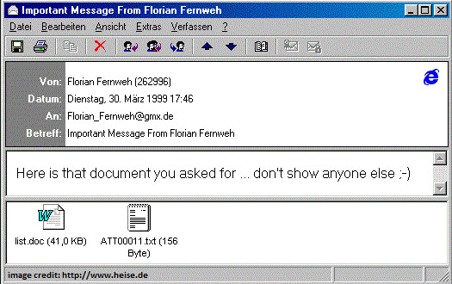

Slide 5
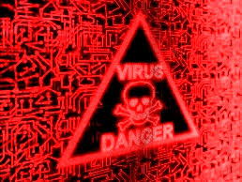
EFFECTS OF THE VIRUS
Unpredictable behaviour of the computer
Uncertain error messages
Windows showing blue screen errors
A downtime in system errors
Programs abruptly stop working
Random spam messages
Abrupt deletions of files and folders

Slide 6

DAMAGES CAUSED BY THE VIRUS
The Melissa Virus corrupted hundreds of thousands of computers and reportedly caused $80 million dollars of damage in North America and $1.1 billion worldwide.

Slide 7
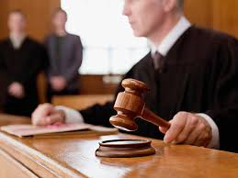
HOW WAS THE VIRUS CONTROLLED?
The creator of Melissa, David L Smith posted the infected on file on a popular newsgroup website. The post was easily tracked by investigators through the hacker’s email and IP address. David Smith was arrested and received a jail sentence for ten years but only served 20 months and received a fine of $5,000. After months of the Smith’s arrest, the virus continued to spread until software manufacturers were able to patch and prevent the virus. There are very few cases of the Melissa Virus occurring today.

Slide 8

SOURCES
https://malware.wikia.org/wiki/Melissa
https://techspirited.com/things-you-need-to-know-about-melissa-virus
https://computer.howstuffworks.com/worst-computer-viruses1.htm
https://searchsecurity.techtarget.com/definition/Melissa-virus
https://www.cnet.com/news/melissa-virus-turns-10/

Slide 9


